Slide 1
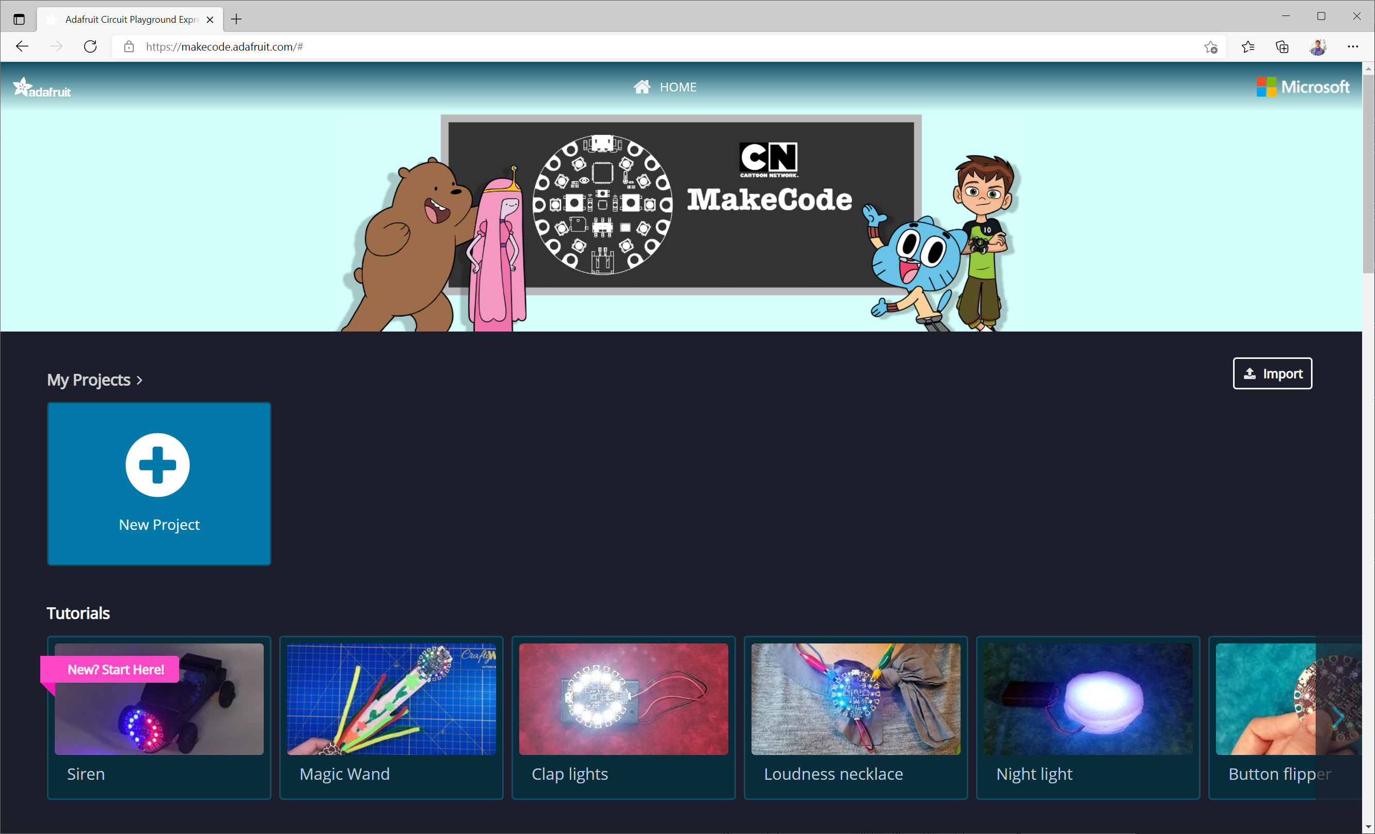
Click new project

Slide 2
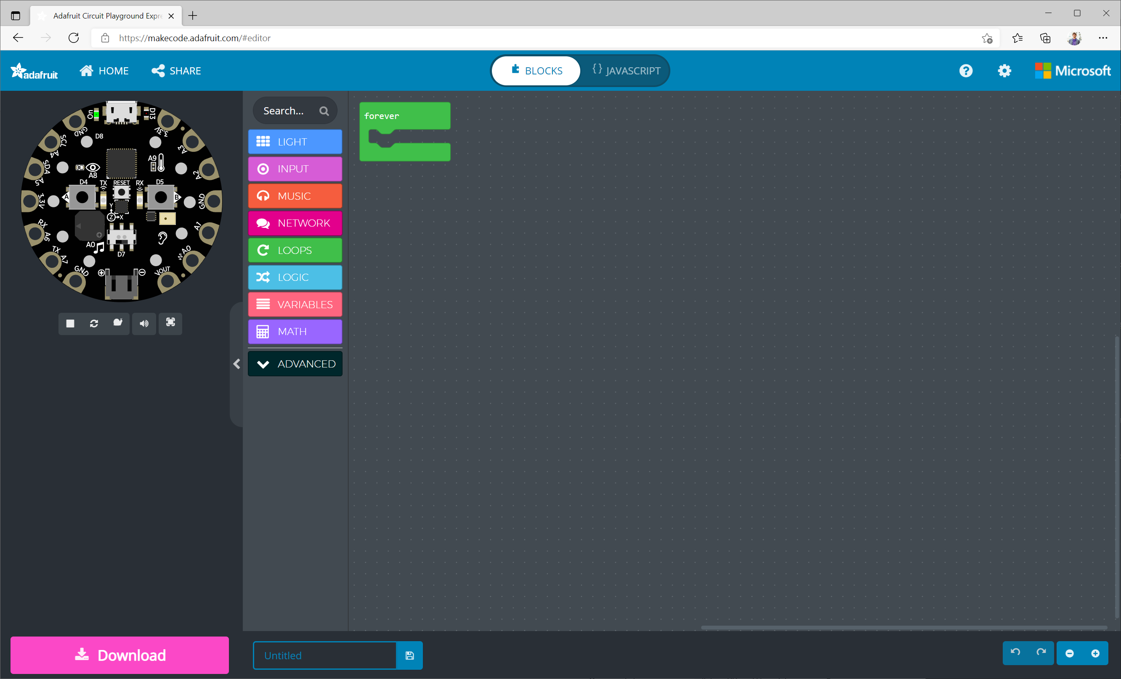
Forever block
This block starts automatically and runs forever. We’ll put our code in here.

Slide 3
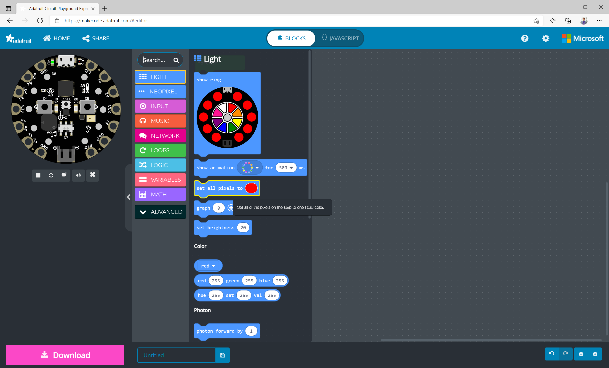
1
Click on the “light” menu in the toolbox
2
Drag-and-drop the “set all pixels to” block to the workspace

Slide 4
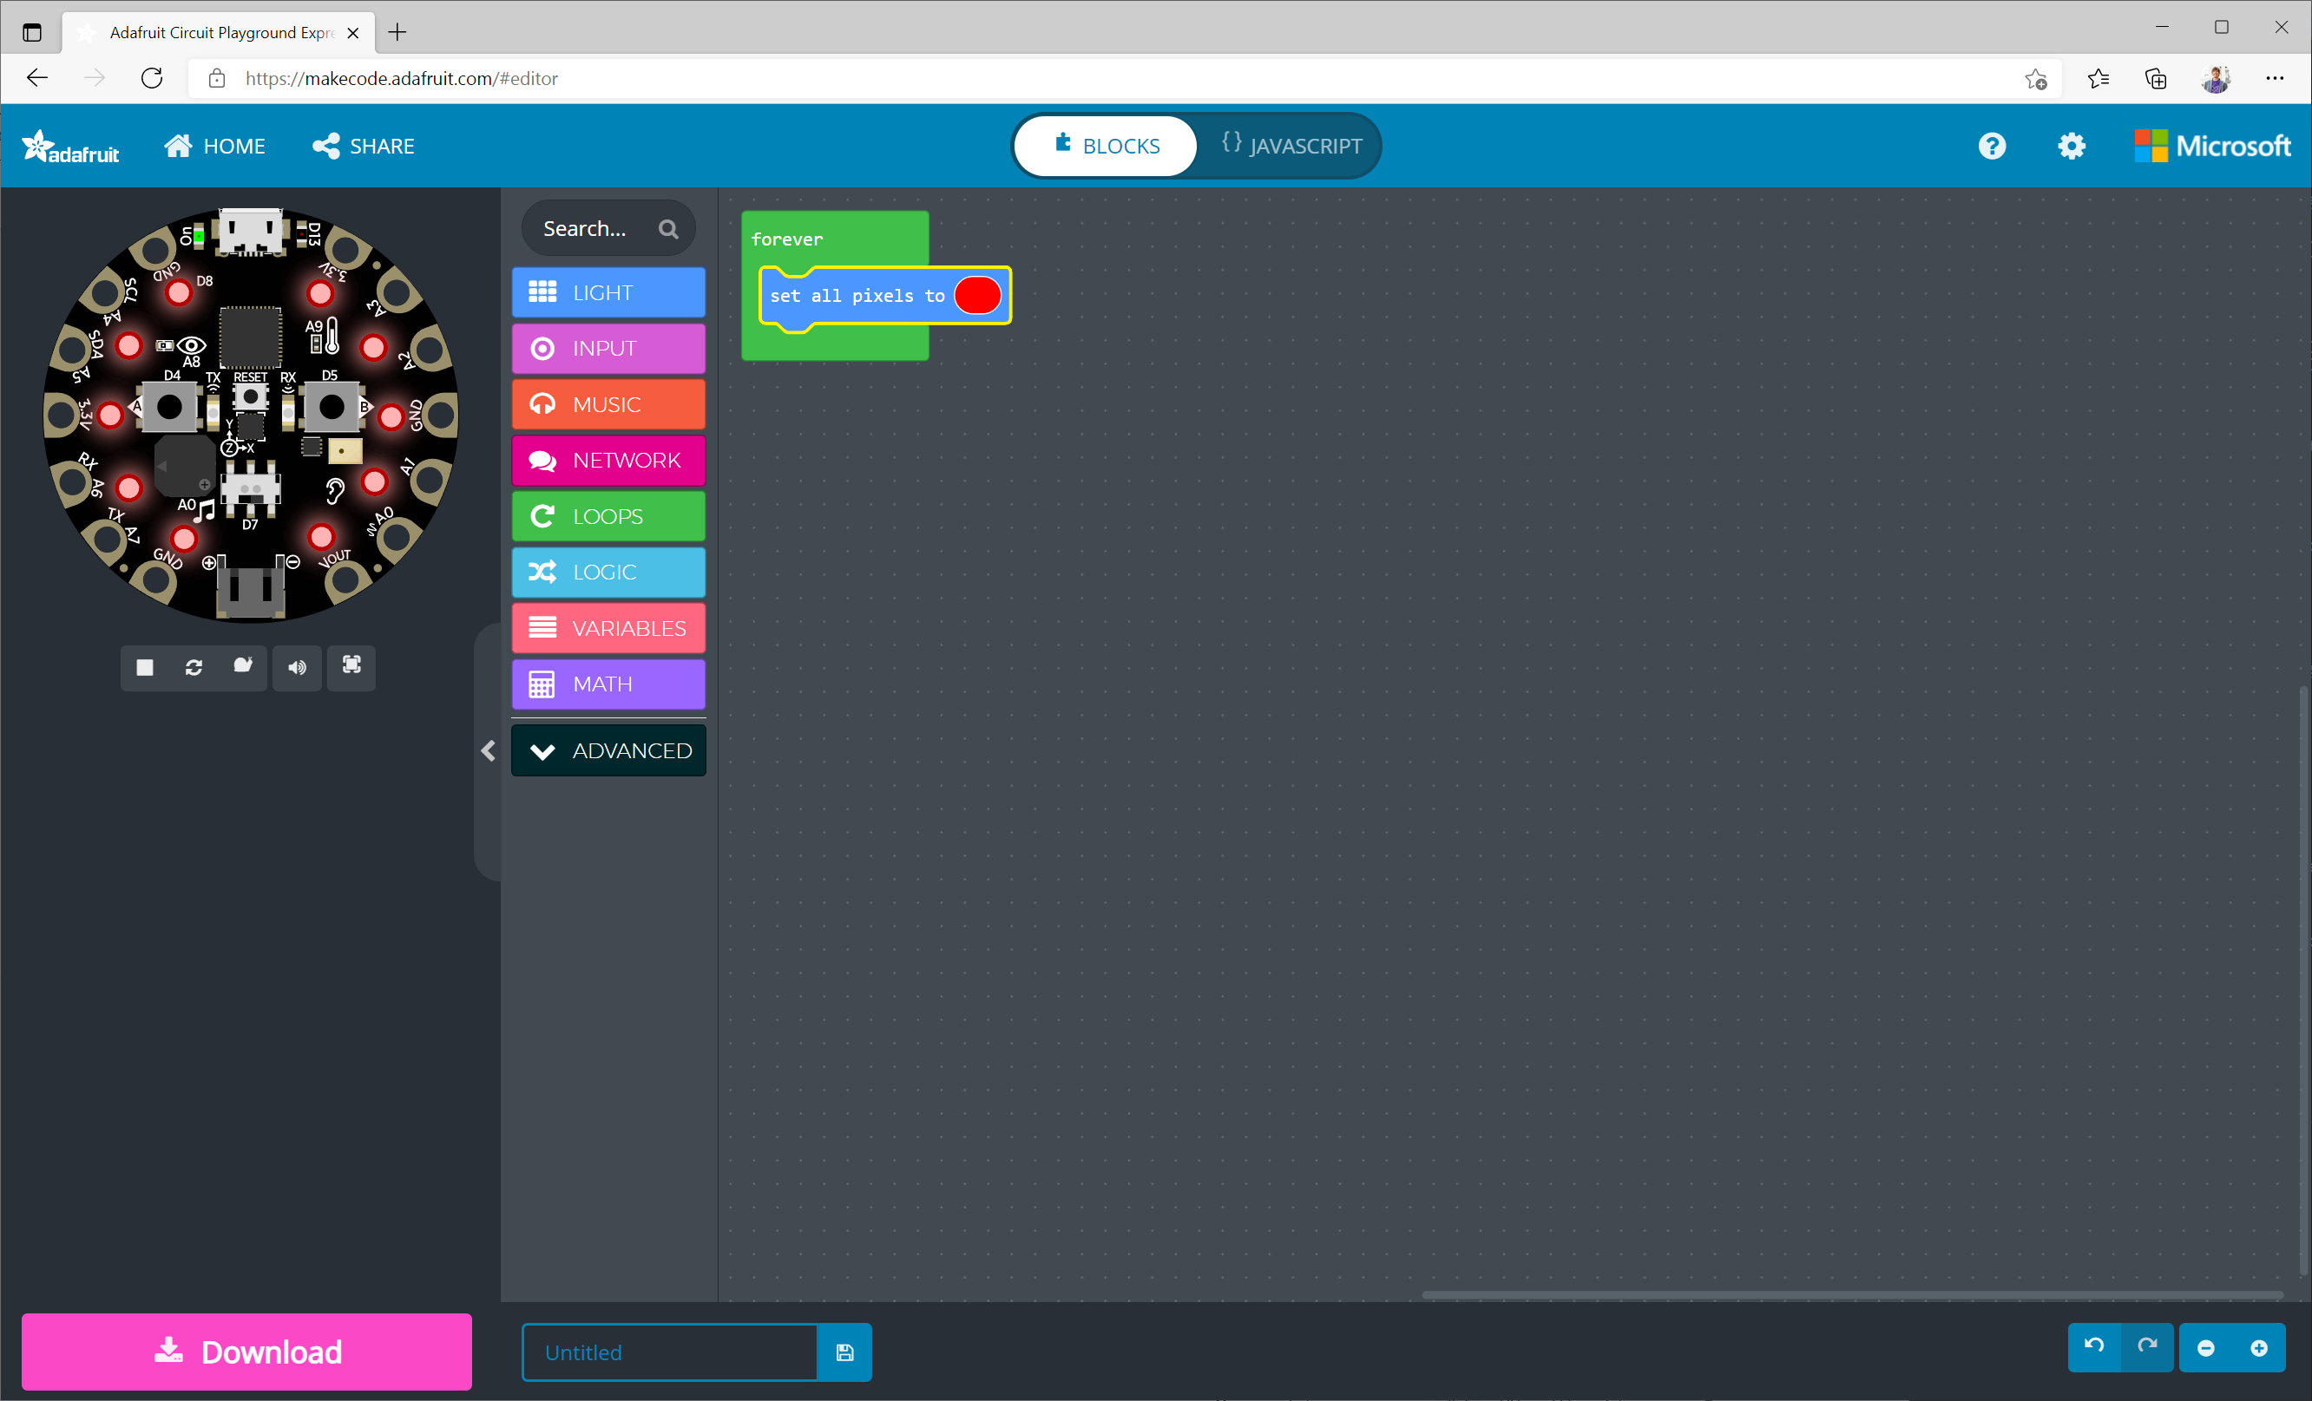
“Set all pixels to” block
This block sets all of the NeoPixels to the selected color, which is currently red.

Slide 5
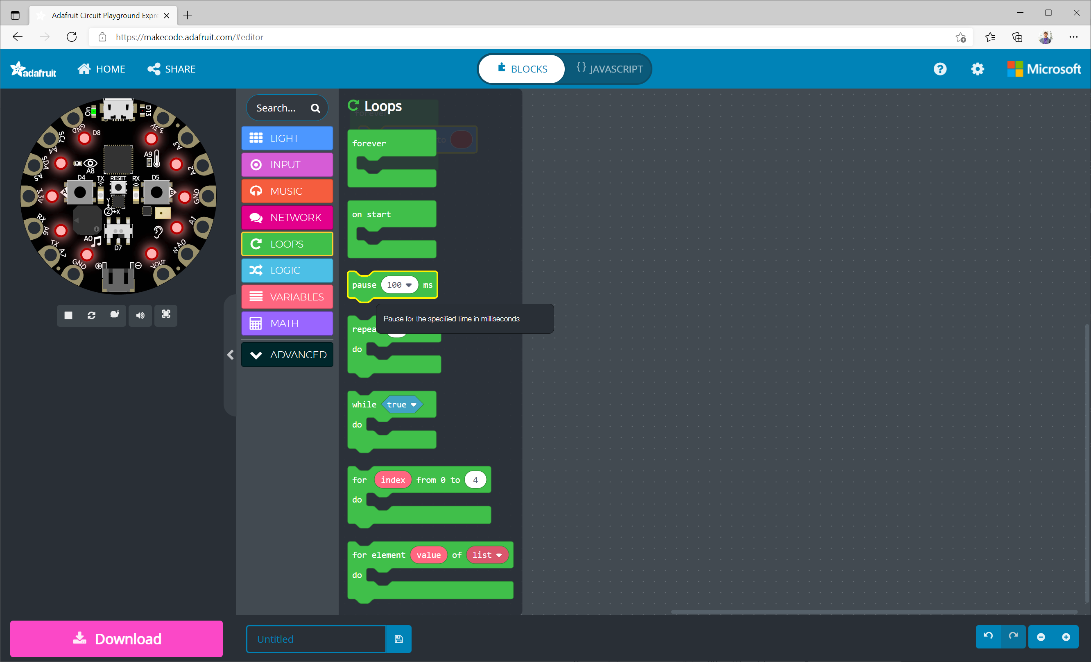
1
Click on the “Loops” menu in the toolbox
2
Drag-and-drop the “pause” block to the workspace

Slide 6
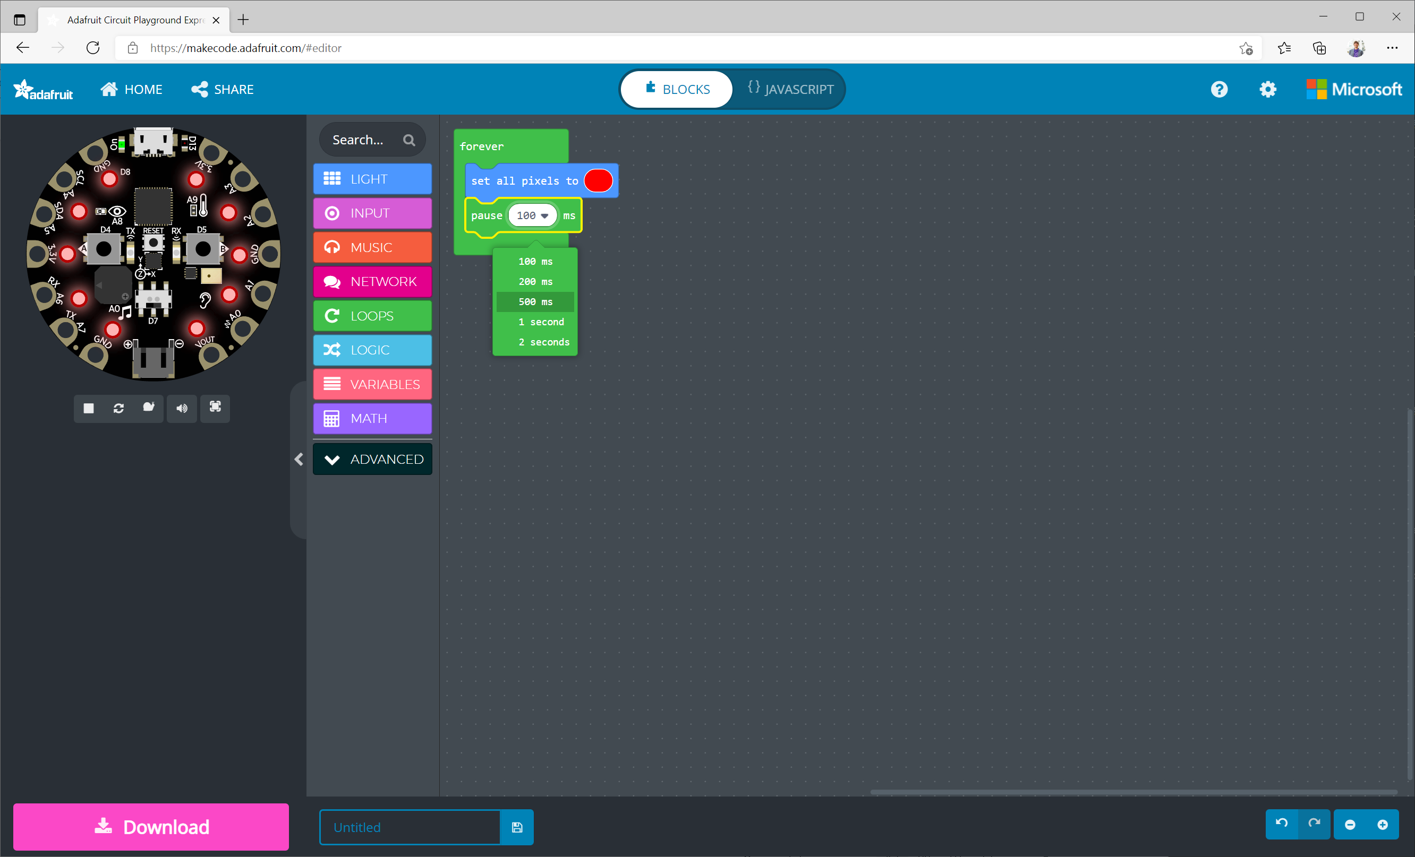
“pause” block
This block pauses your program for the given amount of time. Let’s set it to 500ms.

Slide 7

1
Click again on the “light” menu in the toolbox
2
Drag-and-drop the “set all pixels to” block to the workspace

Slide 8
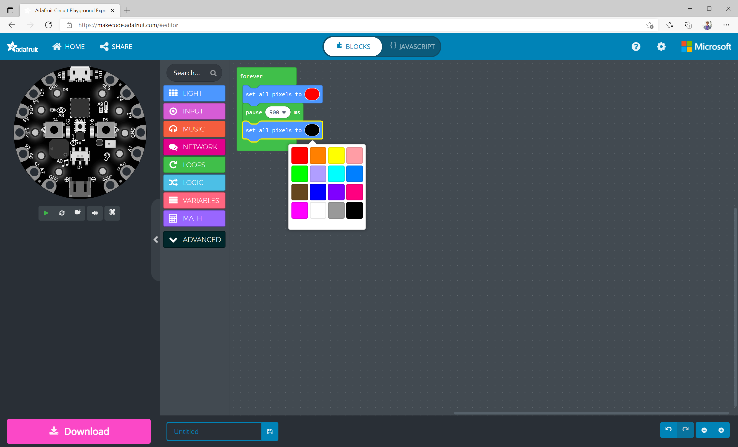
Turn off the lights
Click on the colored oval to change the color. Select “black” to turn off the lights.

Slide 9
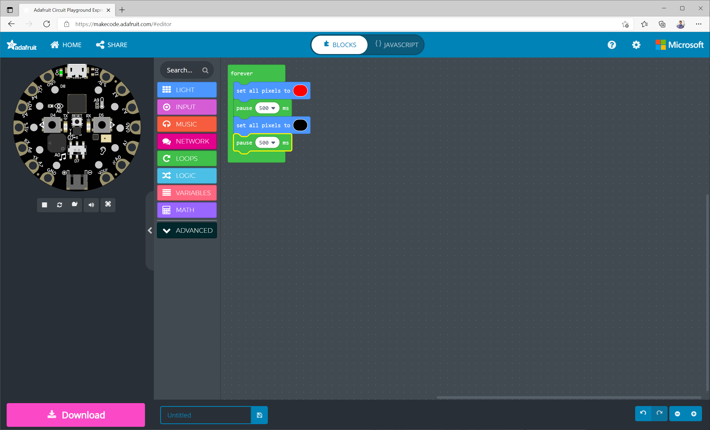
Final “pause” block
Pause the program again so that the lights are all black (off) for 500ms.

Slide 10
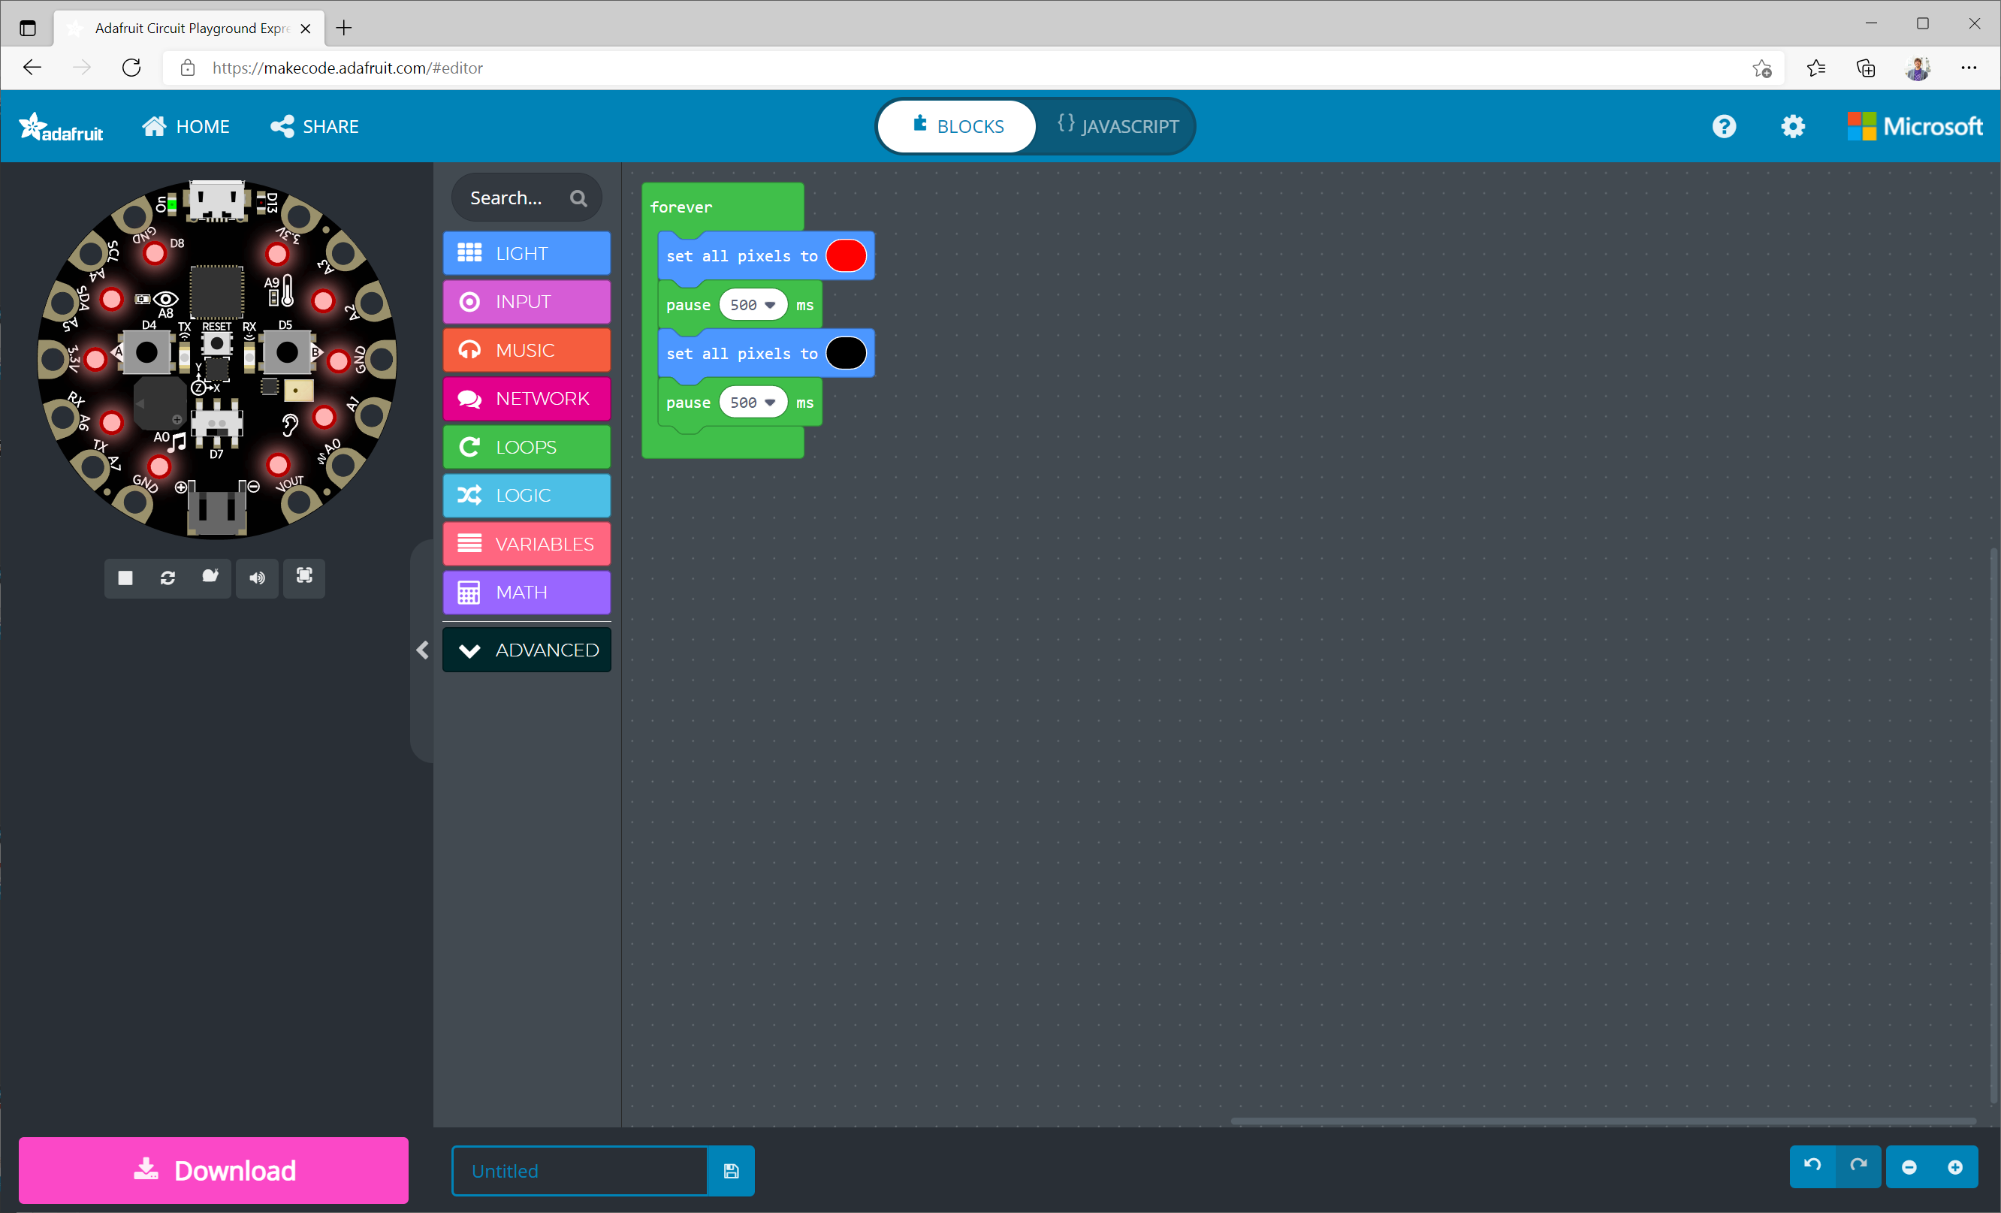
Neverending loop
After the last pause, the program starts over because of the “forever” block. Your program will loop repeatedly forever!

Slide 11

1
Click on the “Loops” menu in the toolbox
2
Drag-and-drop the “on start” block to the workspace

Slide 12
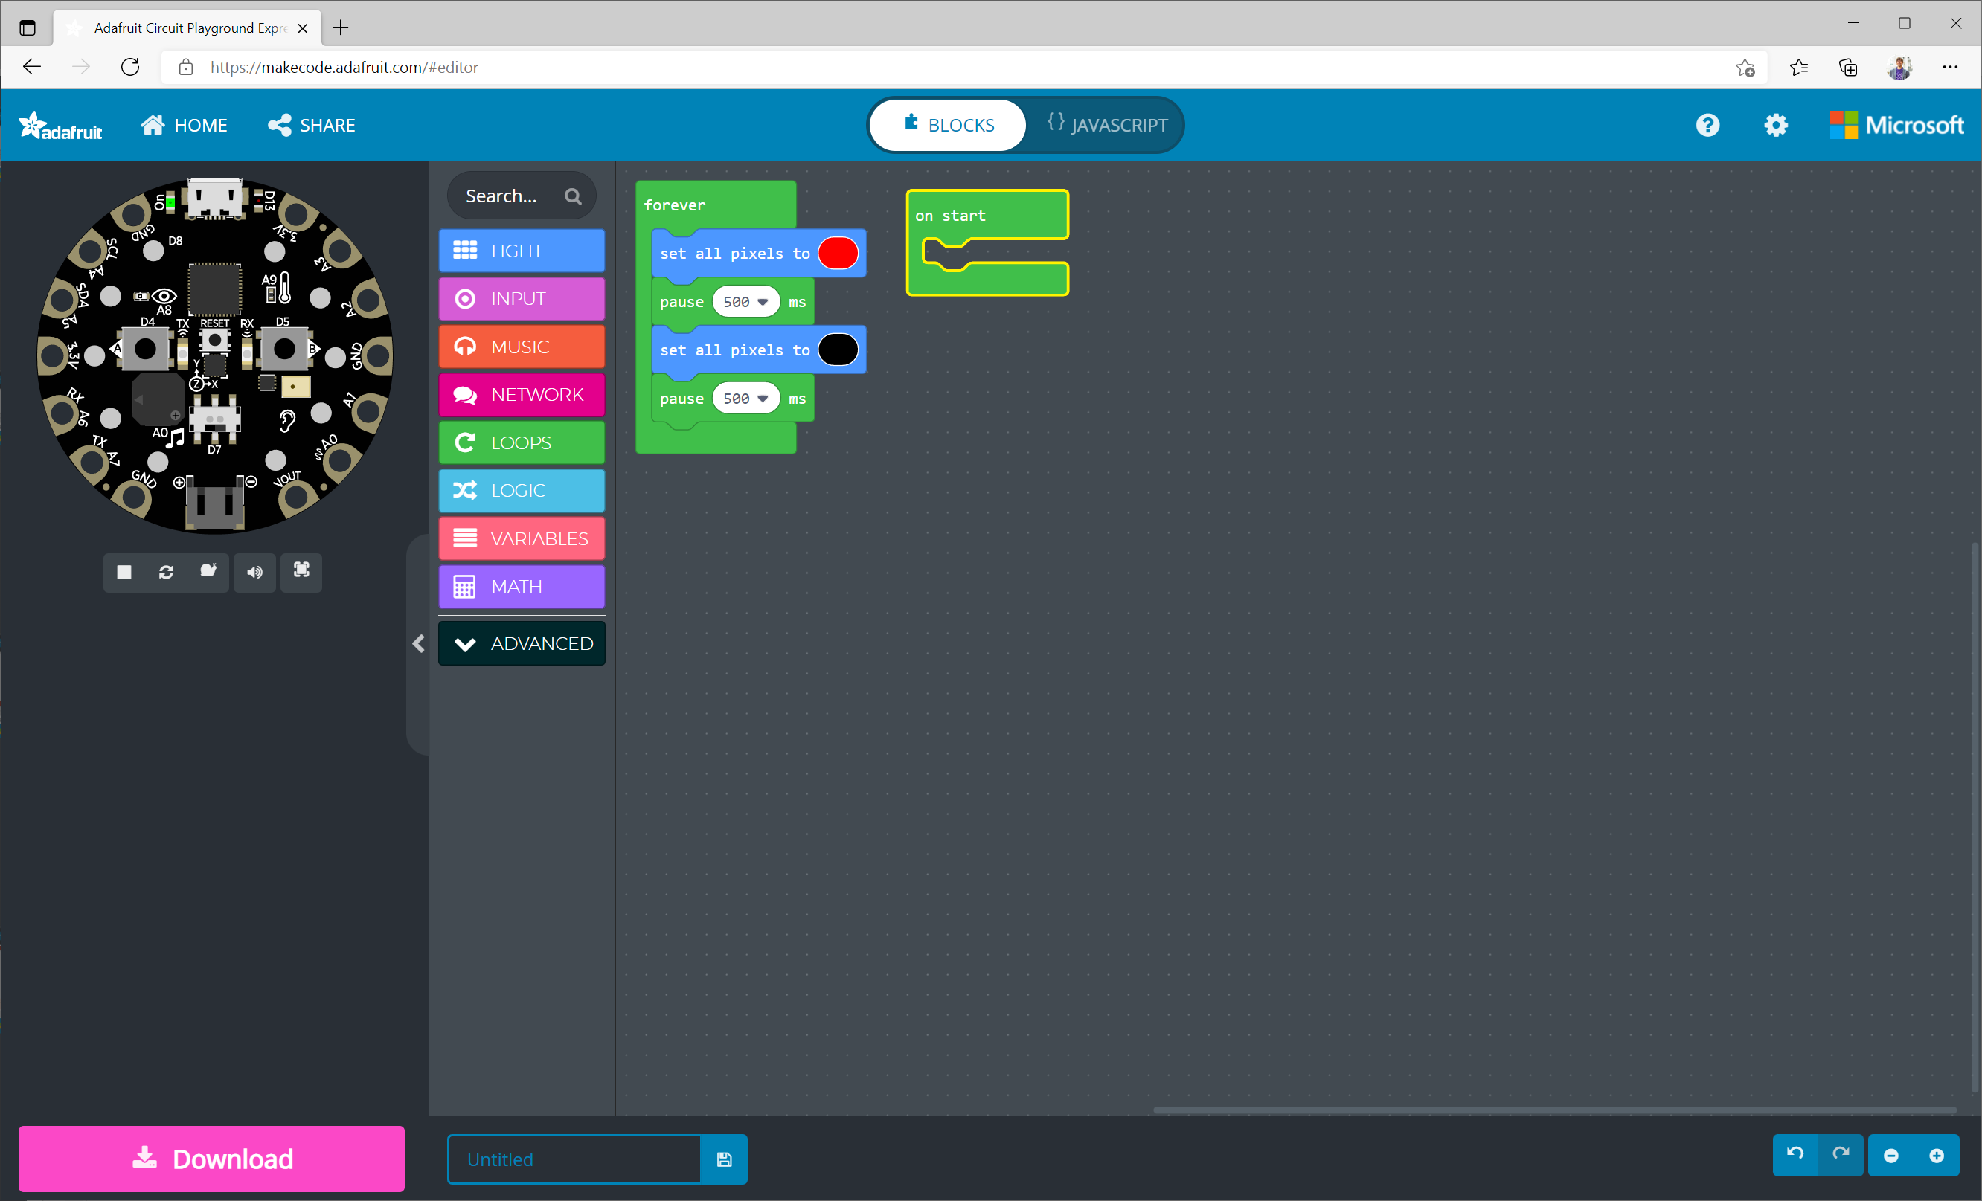
“on start” block
Runs automatically when the CPX starts up (e.g., after you plug it in or hit the reset button)

Slide 13
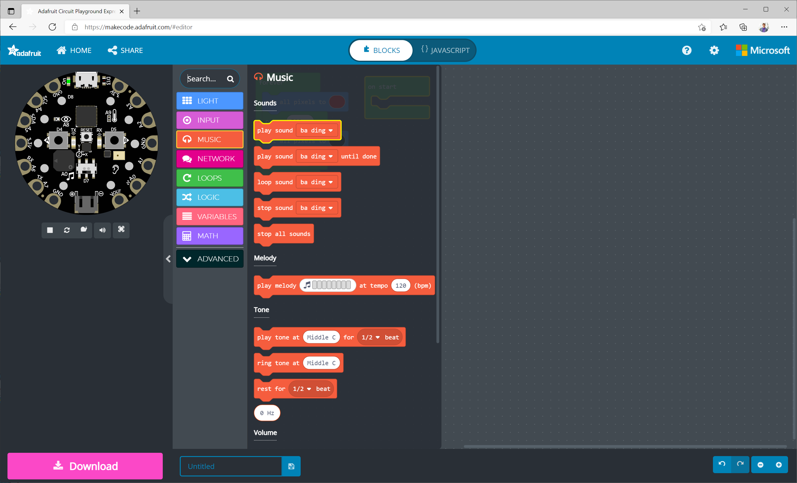
1
Click on the “music” menu in the toolbox
2
Drag-and-drop the “play sound” block to the workspace

Slide 14
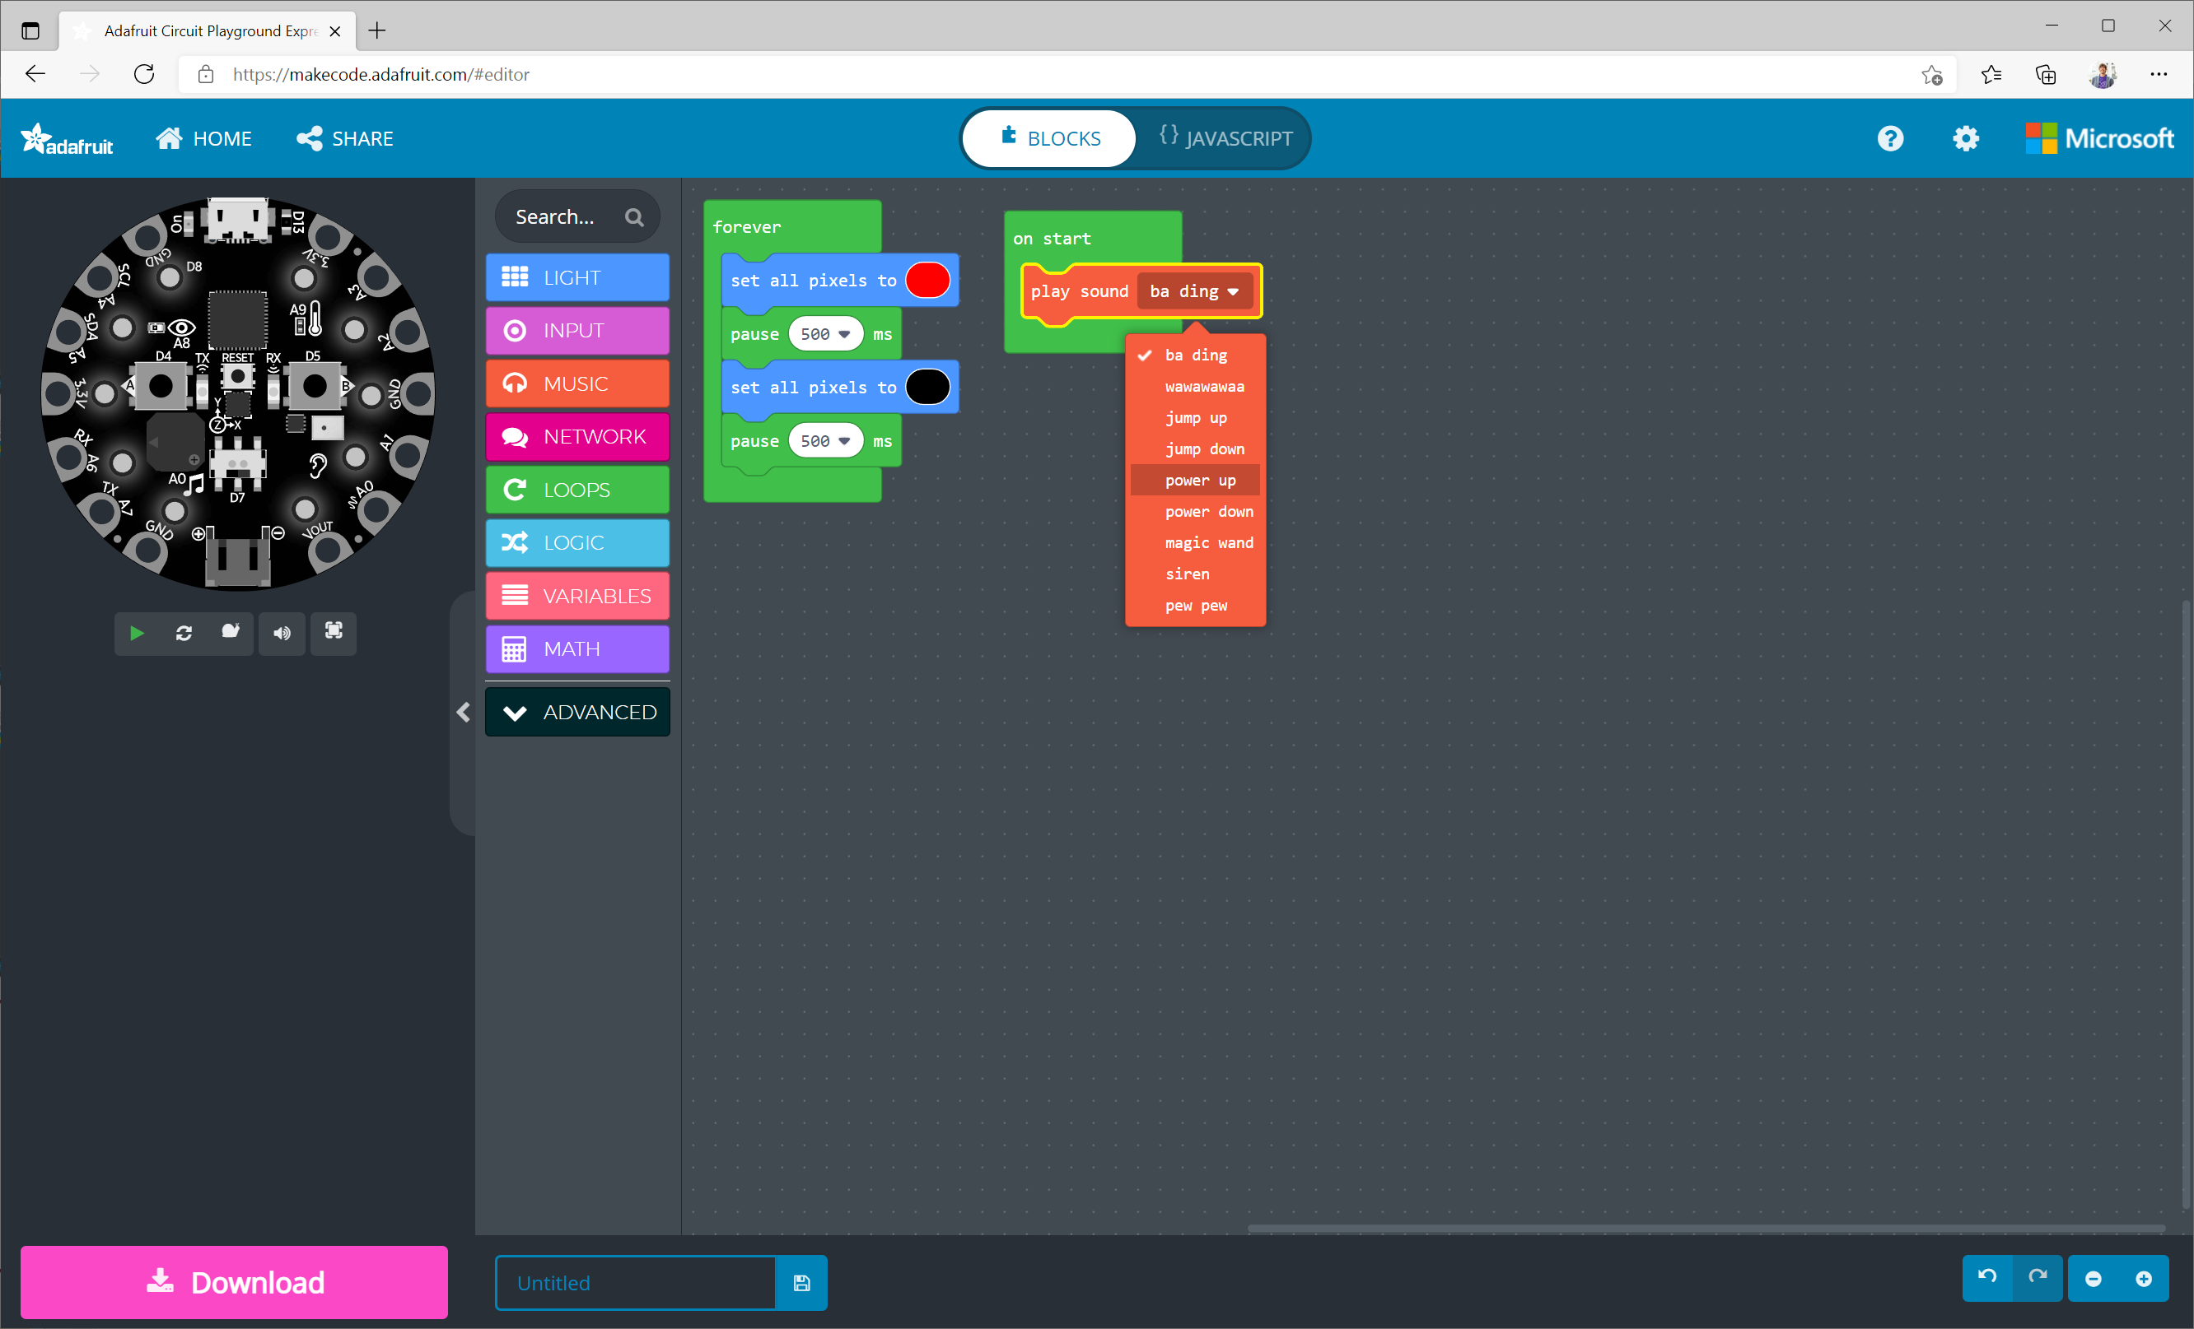
“play sound” block
Plays the selected sound

Slide 15
